Slide 1


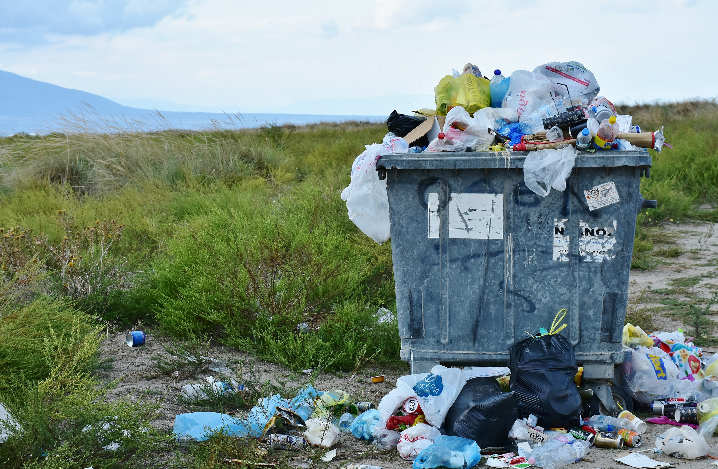


ICE-4108 | Artificial Intelligence Lab
Project Proposal
AI-POWERED SMART
WASTE CLASSIFICATION SYSTEM WEBAPP
An Intelligent Object Detection-Based Waste Sorting Solution
Presented By:
Ruponti Muin Nova (2254901038)
Sadia Alam (2254901048)
Department of ICT, BUP
Presented To:
Nazneen Akter, Assistant Professor, ICT, BUP
Md. Sazzadul Islam Prottasha
Lecturer, ICT, BUP

Slide 2

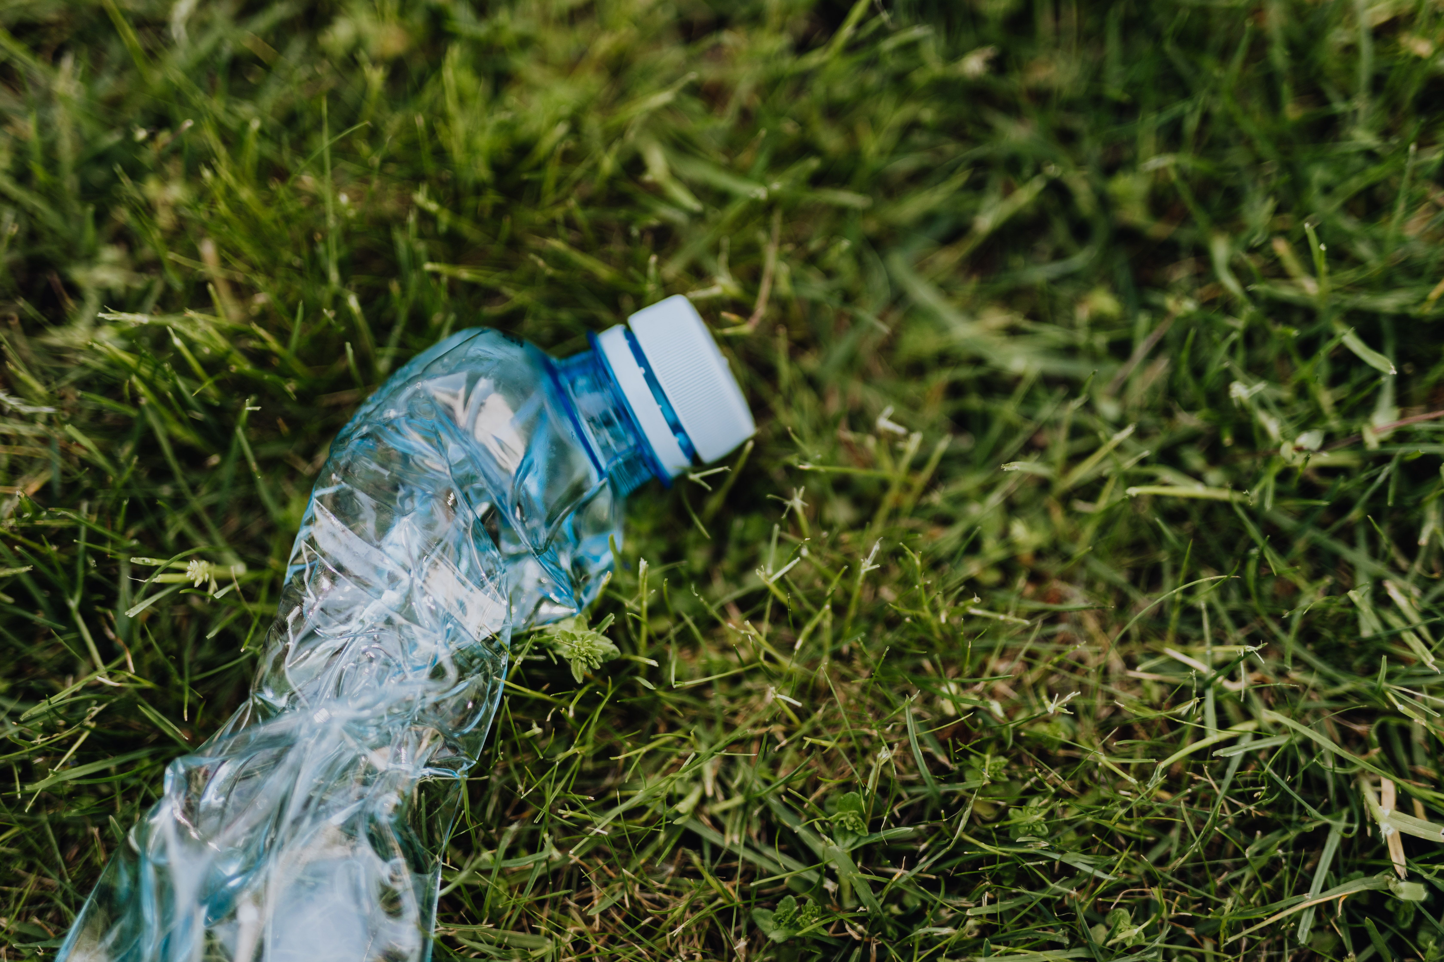
ICE-4108 | Artificial Intelligence Lab
INTRODUCTION
In Dhaka city, frequent drain clogs and waterlogging during rain are common due to poor waste management.
Many people cannot properly identify or separate waste types before disposal.
This project proposes an AI-based system to automatically detect and classify waste from images— improving sorting efficiency, reducing human effort,and promoting sustainable waste management.

Slide 3

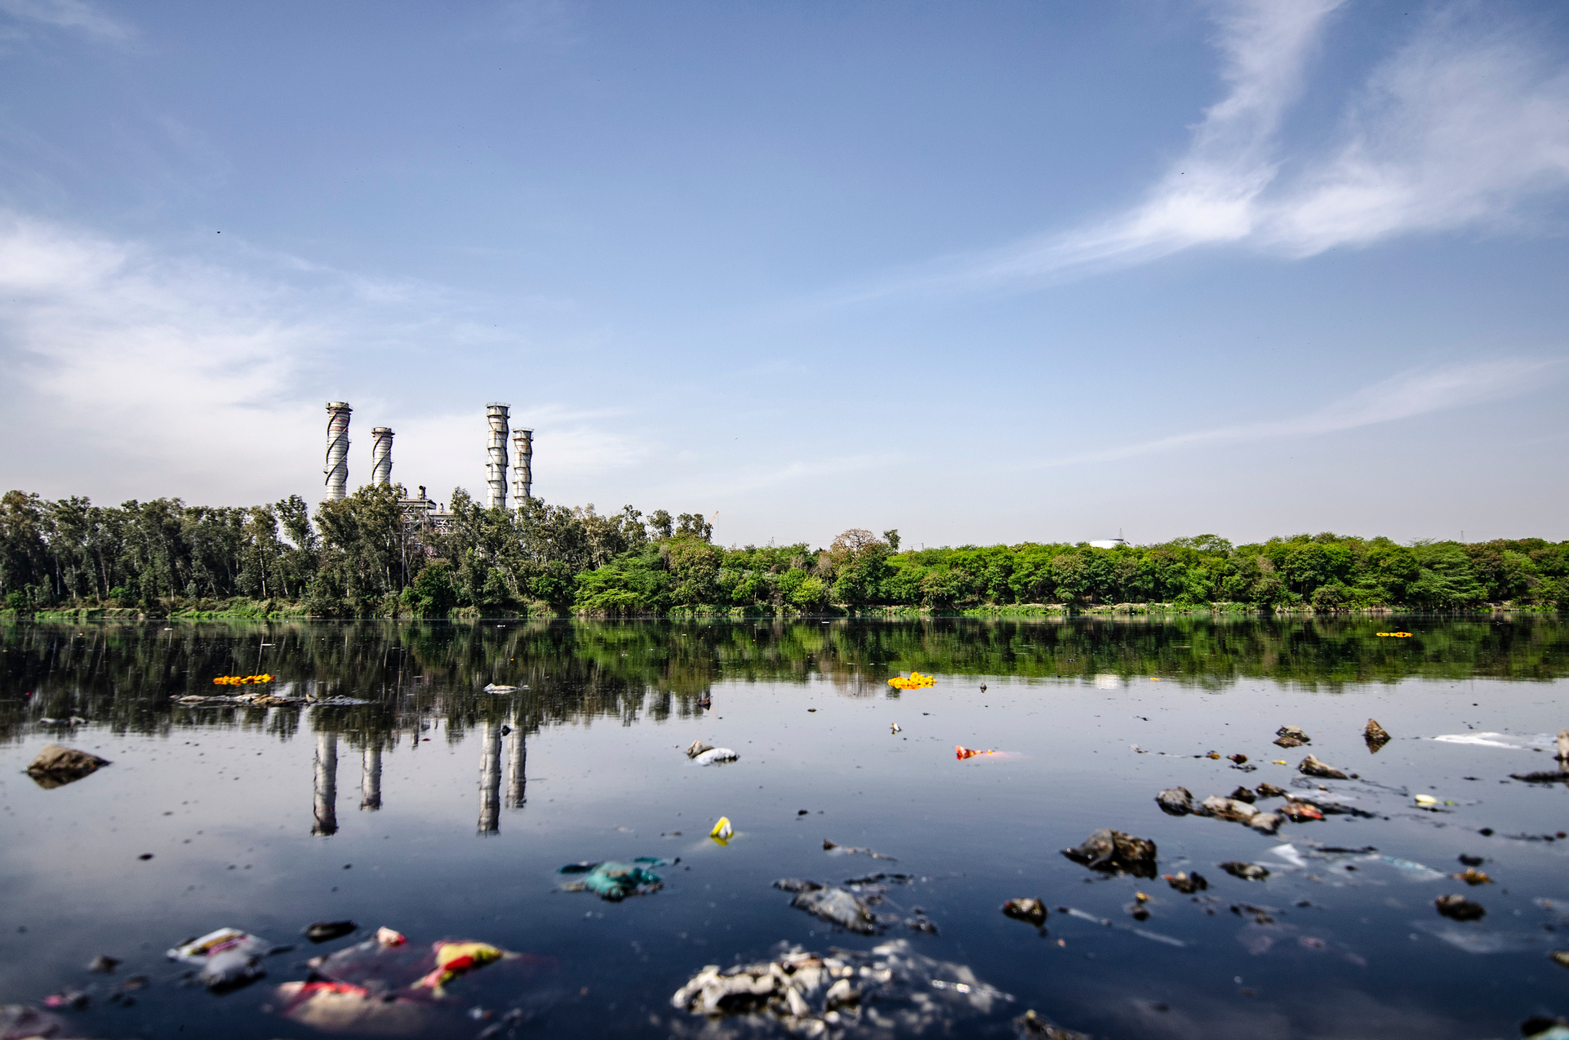
ICE-4108 | Artificial Intelligence Lab
PROBLEM STATEMENT
Lack of automated waste segregation systems.
Manual sorting exposes workers to health hazards.
Need for a smart, low-cost, and accessible solution that can operate via simple web or camera input.

Slide 4


ICE-4108 | Artificial Intelligence Lab
OBJECTIVES
OF OUR PROJECT
Develop an AI model capable of detecting waste types from images.
Build a Flask-based backend for AI inference and API services.
Design a React-based web interface for end users to upload images.
Classify waste into categories such as Plastic, Paper, Metal, Organic and others
Enable future scalability for IoT Smart Bin automation.

Slide 5
ICE-4108 | Artificial Intelligence Lab
WORKFLOW
User uploads image through web UI.
Flask API receives input and processes it using the
CNN model.
Model detects and classifies waste items.
Results returned as JSON.
React displays detections visually to the user.

Slide 6
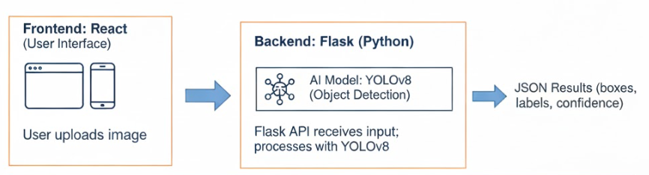
ICE-4108 | Artificial Intelligence Lab
PROPOSED SYSTEM (VISUAL)
CNN MODEL
CNN MODEL

Slide 7






ICE-4108 | Artificial Intelligence Lab
TECHSTACK
1
2
3
Frontend
Backend
AI Model
React.js, Axios, Tailwind CSS
Flask (Python), REST API
CNN Model, OpenCV, PyTorch
4
5
6
Dataset
Deployment
Version Control
TACO, Kaggle, and Roboflow.
Vercel (frontend), Render/Heroku (backend)
Git & GitHub

Slide 8



ICE-4108 | Artificial Intelligence Lab
EXPECTED OUTPUT
1
2
3
Real-time waste detection from image input.
Detected objects displayed with bounding boxes and labels.
Count summary per category.

Slide 9
ICE-4108 | Artificial Intelligence Lab
THANK YOU

